Slide 1
Lab No 1: Unix Shell Commands

Slide 2
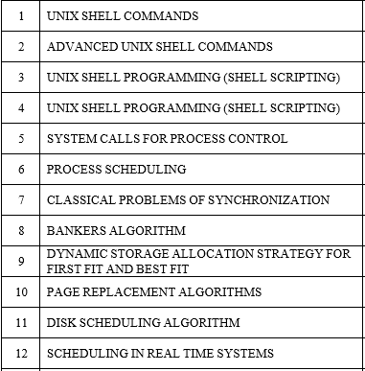
Lab Contents

Slide 3
Course Objectives
To describe the basics of Linux/Unix shell scripting.
To implement operating system concepts.

Slide 4
Course Outcomes
At the end of this course, students will be able to
Work on Unix and Unix like Operating Systems.
Efficiently use the shell commands.
Implement shell script on Unix and Unix like platforms.
Write, compile and debug programs in C language on Unix and Unix like platforms.
Implement of Operating System concepts using C language on Unix and Unix like platforms.

Slide 5
UNIX SHELL COMMANDS
Objectives
To recall the UNIX special characters and commands.
To describe basic commands.

Slide 6
What is shell?
A shell is an environment in which we can run our commands, programs, and scripts.
There are different flavors of shells, just as there are different flavors of operating systems.
Each flavor of shell has its own set of recognized commands and functions.
The shell prompt, $, which is called command prompt, is issued by the shell.

Slide 7
Following is a simple example of date command which displays current date and time:
$date
Shell Types:
In UNIX there are two major types of shells:
1. The Bourne shell. If you are using a Bourne-type shell, the default prompt is the $ character.
2. The C shell. If you are using a C-type shell, the default prompt is the % character.

Slide 8
Demo: Unix shell commands
ls #List files in current directory
ls -l #Lists files in “long” format
cat filename #Show contents of a file
man ls #Get help on the “ls” command
pwd (“Print Working Directory”): Shows the current location in the directory tree.
cd <dirName>: changes current path to the specified directory name.

Slide 9
Special Characters
There are many symbols and characters that the shell interprets in special ways.
This means that certain type of characters:
a) cannot be used in certain situations
b) may be used to perform special operations
c) must be “escaped” if you want to use them in a normal way.

Slide 10
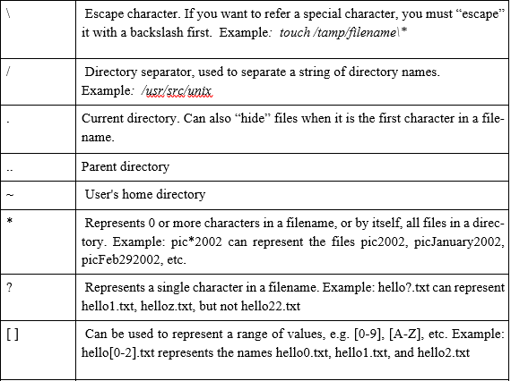

Slide 11
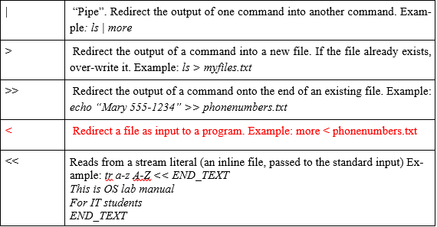

Slide 12
Working With Files and Directories
head: Display the first few lines of a text file.
tail: Display the last few lines of a text file.
cp: Copies a file from one location to another
mv: Moves a file to a new location, or renames it.
rm: Delete a file.
mkdir: Make Directory.

Slide 13
Commands used for Finding Things
which: Shows the full path of shell commands found in your path
$which grep
whereis: Locates the program, source code, and manual page for a command
$whereis ls
find: search for files matching certain patterns
$find . -name *.sh

Slide 14
Shortcuts
ctrl+c Halts the current command
ctrl+z Stops the current command,
ctrl+d Logout the current session, similar to exit
ctrl+w Erases one word in the current line
ctrl+u Erases the whole line
!! Repeats the last command
exit Logout the current session

